Slide 1

Predicting Age with Multiple Linear Regression

Slide 2
Agenda
Introduction
Hypothesis
Data-Analysis Process
Data Visualizations
Findings
Limitations
Summary

Slide 3
Introduction
Kim Fowler
Completing a Master's degree in Data Analytics from WGU
Database Developer with 10 years of experience
Predicting a person's age (years) from a set of health and lifestyle variables

Slide 4

Hypothesis

Slide 5

A defined set heath and lifestyle variables statistically significantly affect Age (years).
Hypothesis - The variables Cholesterol Level, Bone Density, Blood Glucose Level, Vision Sharpness, Hearing Ability, and Smoking Status do impact Age (years).
Alterative Hypothesis - The variables Cholesterol Level, Bone Density, Blood Glucose Level, Vision Sharpness, Hearing Ability, and Smoking Status do not impact Age (years).

Slide 6

Data-Analysis Process
Data Collection
Exploratory Data Analysis
Prepare the Data
Data Wrangling
Predictive Modeling
Feature Selection
Model Evaluation

Slide 7
Data Visualizations
Gaining insight into the data

Slide 8
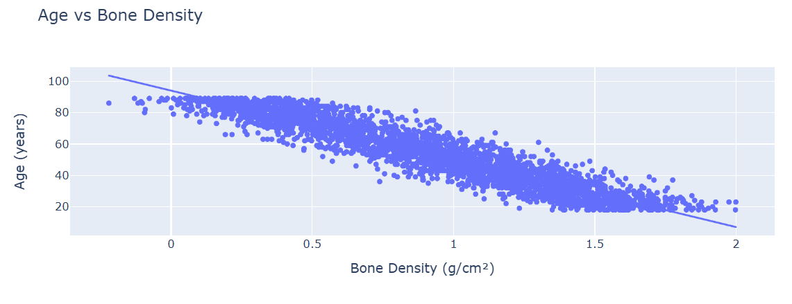
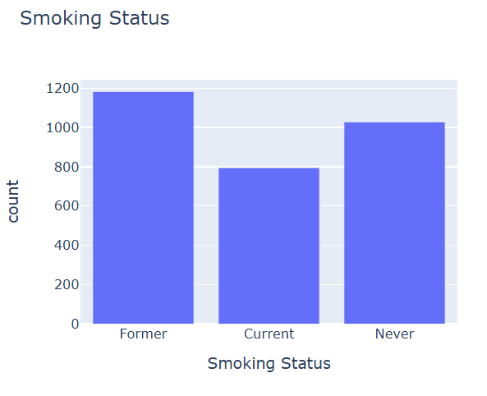
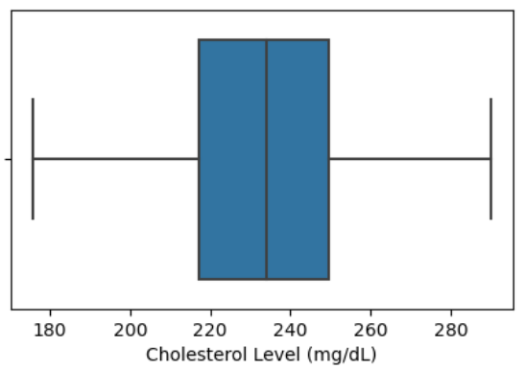
Visualizations to explore the Data

Slide 9

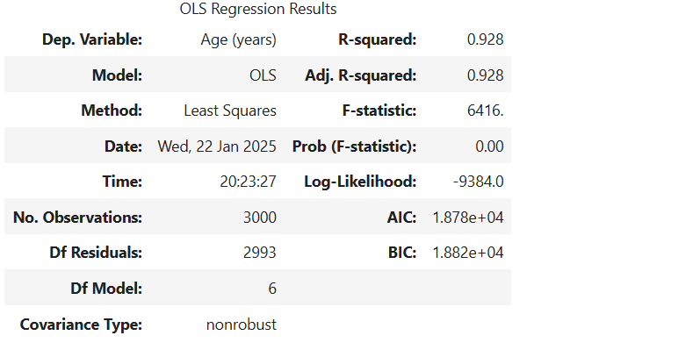
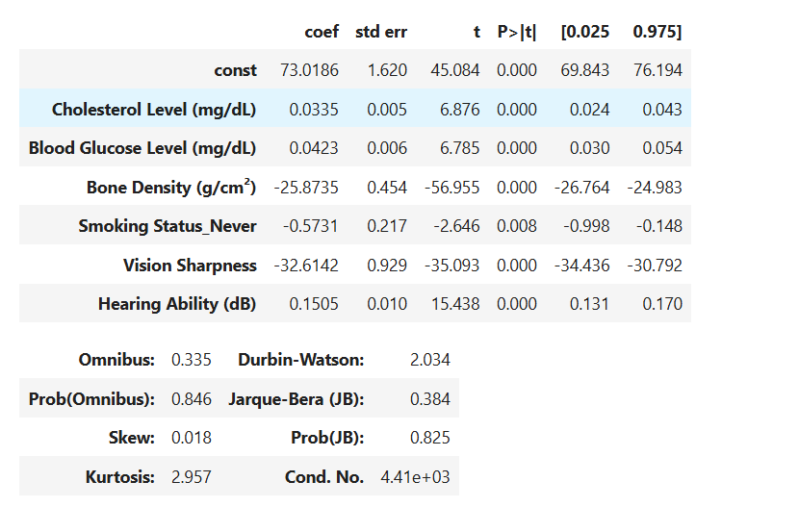
Research Findings

Slide 10
This model can be used to predict a person’s age, thus helping to determine if they are a longevity risk
Formula:
Age (years) = 73.02 + 0.03 (Cholesterol Level) + 0.04 (Blood Glucose Level) - 25.87 (Bone Density)
– 32.61 (Vision Sharpness) + 0.15 (Hearing Ability) - 0.57 (Smoking Status)

Slide 11
Limitations
Multiple Linear Regression Limitations – sensitive to outliers. Outliers must be handled carefully before performing analysis.
Data Limitations – The major life insurance company’s data may not include all the relevant health and lifestyle variables.

Slide 12

Next Steps
Gather comprehensive health and lifestyle information on current customers and their beneficiaries.
Collect similar health and lifestyle information for new customers and their beneficiaries.

Slide 13

Conclusion
By using a predictive multiple linear regression model, insights can be gained into whether an individual may be considered a longevity risk.
Identifying individuals who are likely to live longer than expected allows life insurance companies to take proactive measures to mitigate unexpected cash flow issues.

